Slide 1
File management

Slide 2
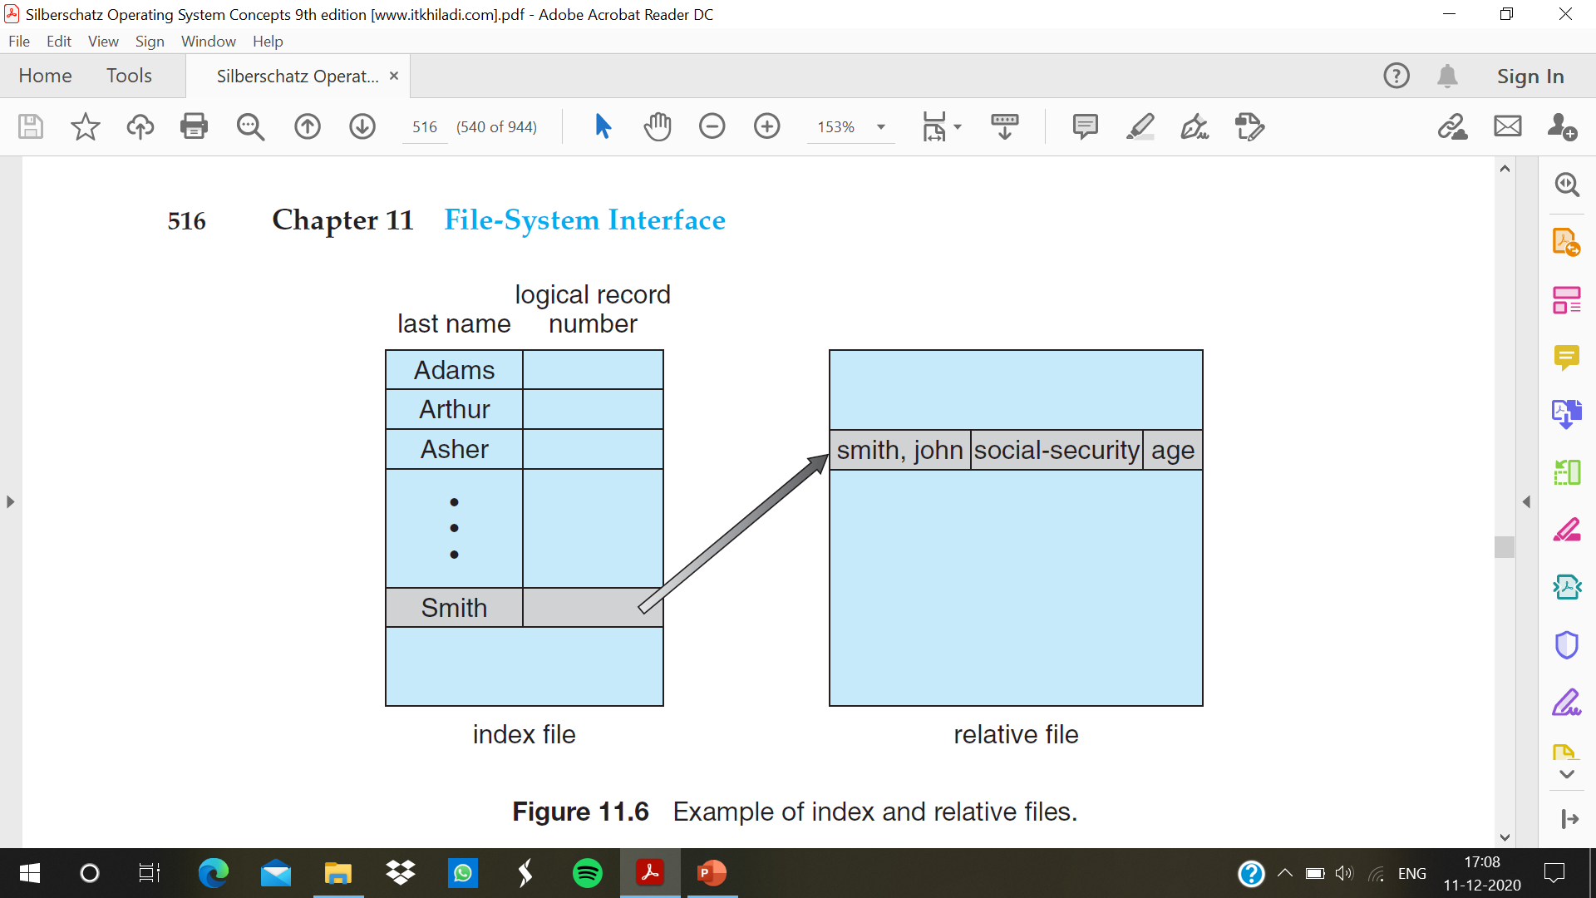

Slide 3
Directory and Disk Structure
Files are stored on random-access storage devices, including hard disks, optical disks, and solid-state (memory-based) disks. A storage device can be used in its entirety for a file system. It can also be subdivided for finer-grained control.
Partitioning is useful for limiting the sizes of individual file systems, putting multiple file-system types on the same device, or leaving part of the device available for other uses, such as swap space or unformatted (raw) disk space.
Any entity containing a file system is generally known as a volume. The volume may be a subset of a device, a whole device, or multiple devices linked together into a RAID set. Each volume can be thought of as a virtual disk.
Each volume that contains a file system must also contain information about the files in the system. This information is kept in entries in a device directory or volume table of contents. The directory records information—such as name, location, size, and type—for all files on that volume.

Slide 4
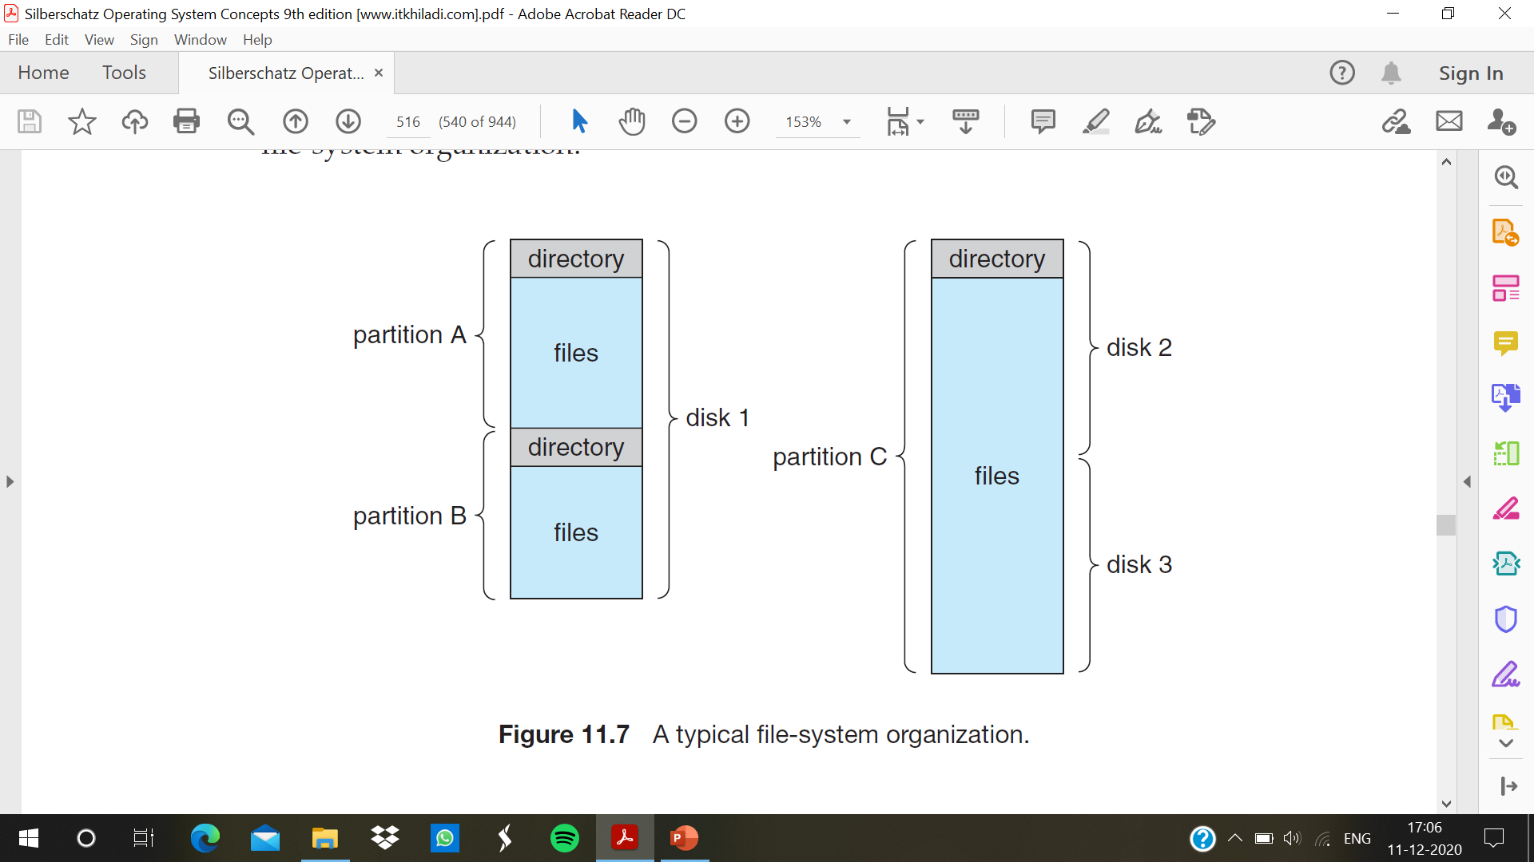

Slide 5
Storage Structure
The types of file systems in the Solaris example mentioned above:
• tmpfs—a “temporary” file system that is created in volatile main memory and has its contents erased if the system reboots or crashes
• objfs—a “virtual” file system (essentially an interface to the kernel that looks like a file system) that gives debuggers access to kernel symbols
• ctfs—a virtual file system that maintains “contract” information to manage which processes start when the system boots and must continue to run during operation
• lofs—a “loop back” file system that allows one file system to be accessed in place of another one
• procfs—a virtual file system that presents information on all processes as a file system
• ufs, zfs—general-purpose file systems

Slide 6
Directory Overview
The directory can be viewed as a symbol table that translates file names into their directory entries. The organization must allow us to insert entries, to delete entries, to search for a named entry, and to list all the entries in the directory

Slide 7
The operations that are to be performed on a directory:
• Search for a file: need to search a directory structure to find the entry for a particular file.
• Create a file: New files need to be created and added to the directory.
• Delete a file: When a file is no longer needed, it can remove it from the directory.
• List a directory: list the files in a directory and the contents of the directory entry for each file in the list.
• Rename a file: Because the name of a file represents its contents to its users, change the name when the contents or use of the file changes. Renaming a file may also allow its position within the directory structure to be changed.
• Traverse the file system: access every directory and every file within a directory structure.

Slide 8
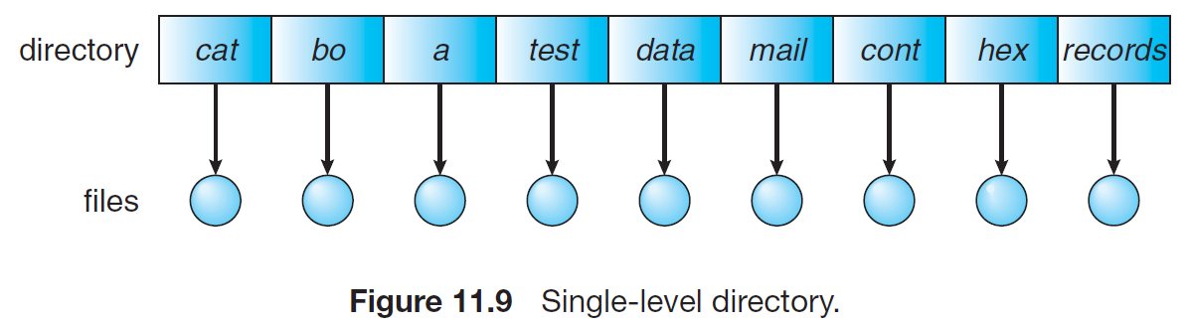
Single-Level Directory
The simplest directory structure is the single-level directory. All files are contained in the same directory, which is easy to support and understand
A single-level directory has significant limitations, however, when the number of files increases or when the system has more than one user. Since all files are in the same directory, they must have unique names.
Keeping track of so many files is a daunting task.

Slide 9
Two-Level Directory
In the two-level directory structure, each user has his own user file directory (UFD). The UFDs have similar structures, but each lists only the files of a single user.
When a user job starts or a user logs in, the system’s master file directory (MFD) is searched. The MFD is indexed by user name or account number, and each entry points to the UFD for that user
When a user refers to a particular file, only his own UFD is searched. Thus, different users may have files with the same name, as long as all the file names within each UFD are unique.
To create a file for a user, the operating system searches only that user’s UFD to ascertain whether another file of that name exists. To delete a file, the operating system confines its search to the local UFD; thus, it cannot accidentally delete another user’s file that has the same name
The sequence of directories searched when a file is named is called the search path. The search path can be extended to contain an unlimited list of directories to search when a command name is given.

Slide 10
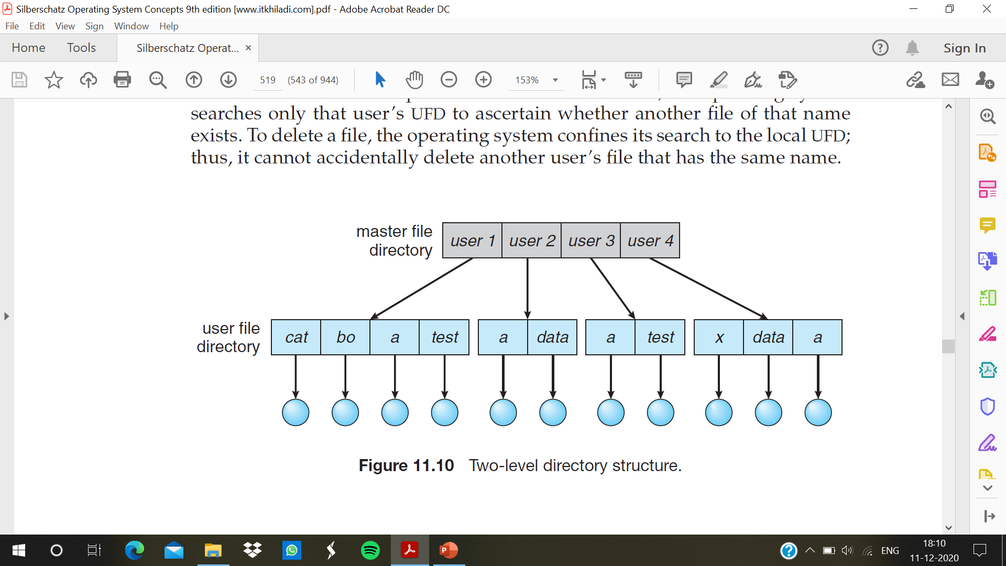

Slide 11
Tree-Structured Directories
A tree is the most common directory structure. The tree has a root directory, and every file in the system has a unique path name.
A directory (or subdirectory) contains a set of files or subdirectories. A directory is simply another file, but it is treated in a special way.
All directories have the same internal format. One bit in each directory entry defines the entry as a file (0) or as a subdirectory (1). Special system calls are used to create and delete directories.
Each process has a current directory. The current directory should contain most of the files that are of current interest to the process.
When reference is made to a file, the current directory is searched. If a file is needed that is not in the current directory, then the user usually must either specify a path name or change the current directory to be the directory holding that file.
Path names can be of two types: absolute and relative. An absolute path name begins at the root and follows a path down to the specified file, giving the directory names on the path. A relative path name defines a path from the current directory.

Slide 12
